Slide 1
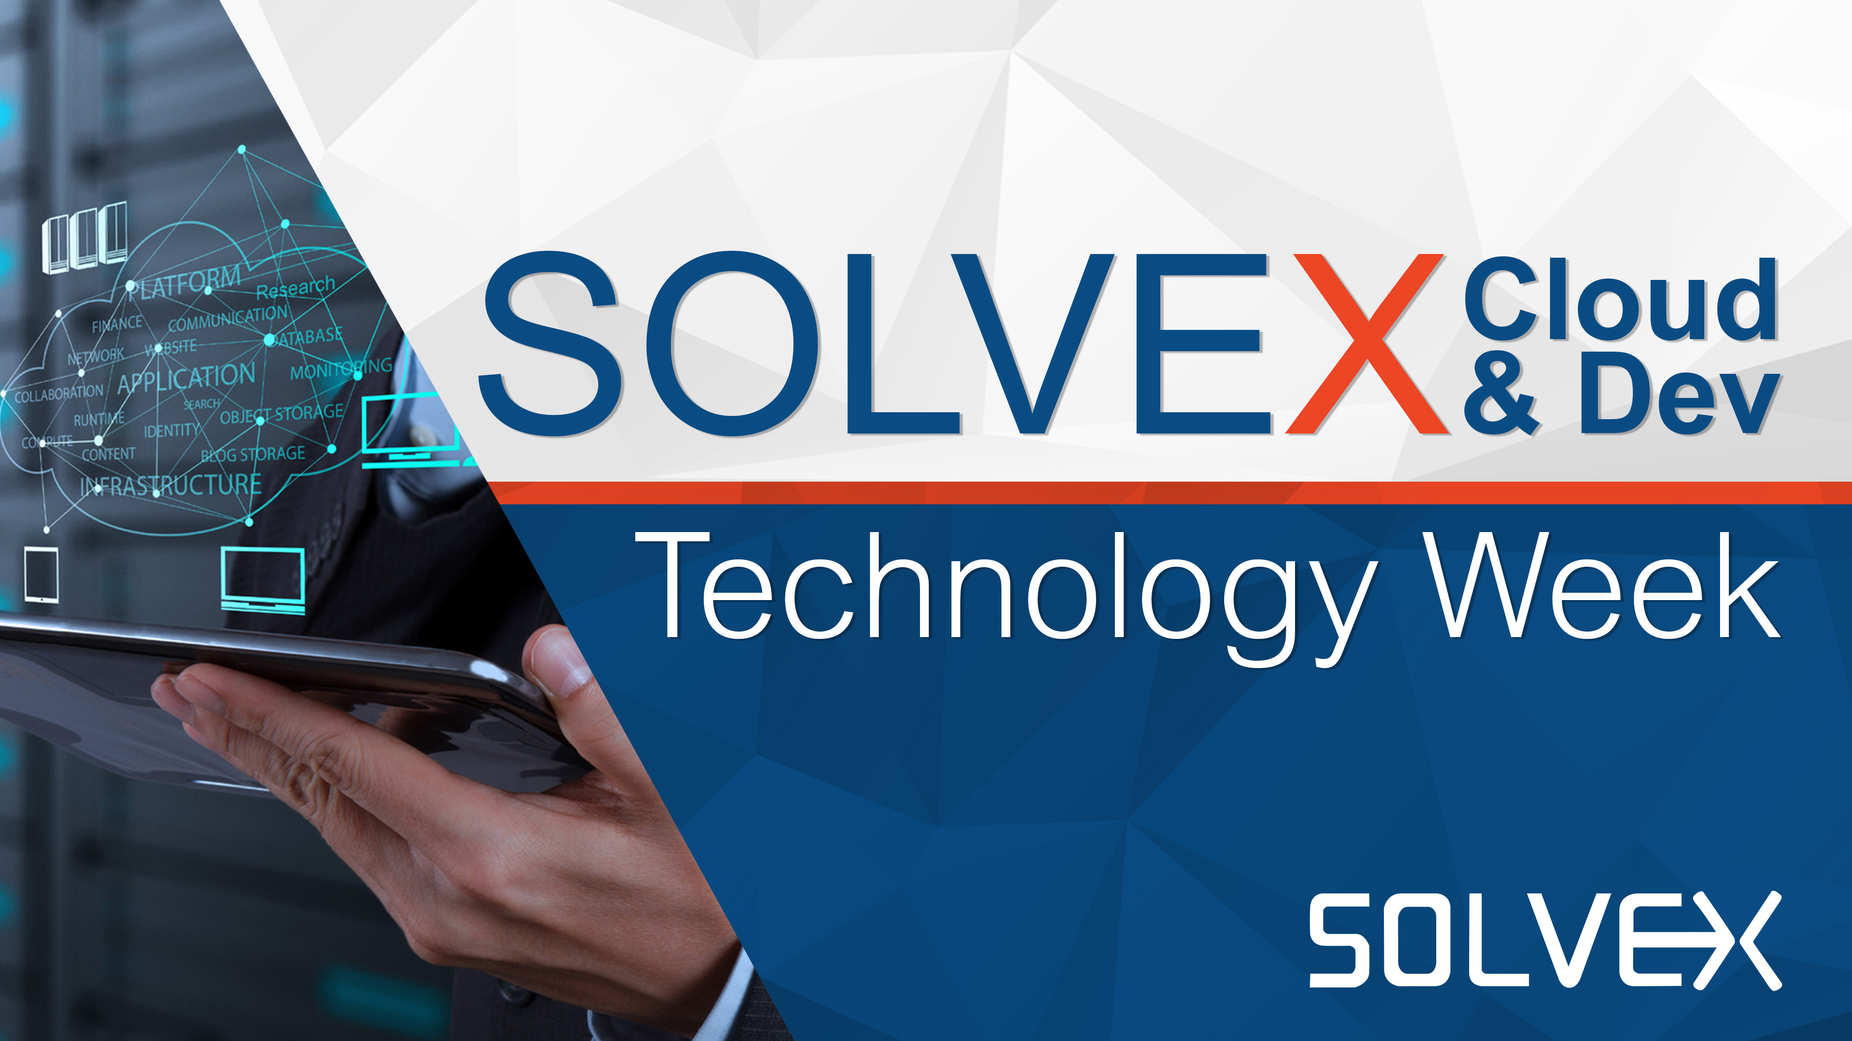

Slide 2
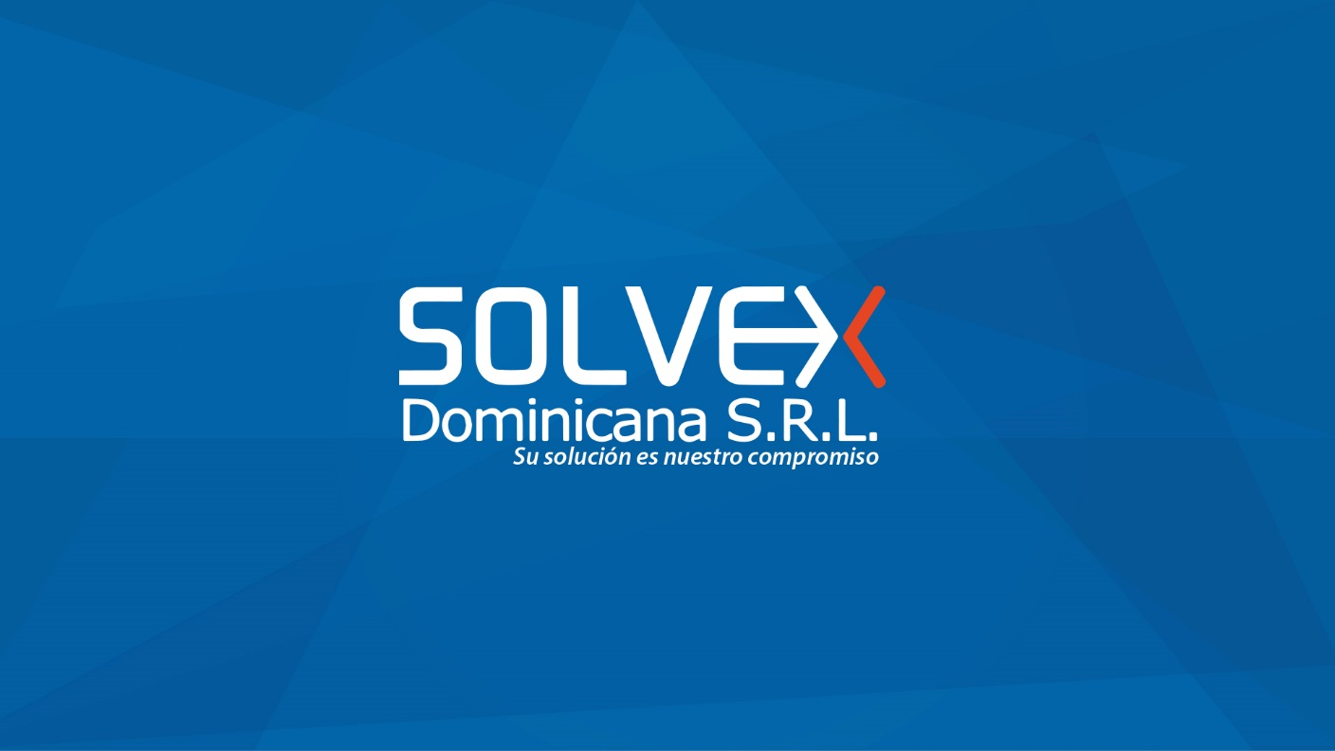
Azure Infrastructure Overview
René A. González F.
Notes:
http://www.azurespeed.com/
http://portal.azure.com/
ID: Evelin.guerra@salessolvexoutlook.onmicrosoft.com
PWD: Nana0289

Slide 3

Microsoft Azure Cloud Models
Higher Cost & More Control Lower Cost & Higher Agility
Traditional On-Premises
IaaS
PaaS
SaaS
Your team manages
Applications
Your team manages
Applications
You manage
Applications
Applications
Runtime
Runtime
Runtime
Runtime
YOUR TEAM MANAGES
MANAGED BY VENDOR
Middleware
Middleware
Middleware
Middleware
Database
Database
Database
Database
Managed by vendor
O/S
O/S
O/S
O/S
Virtualization
Virtualization
Managed by vendor
Virtualization
Virtualization
Servers
Servers
Servers
Servers
Storage
Storage
Storage
Storage
Networking
Networking
Networking
Networking

Slide 4
Microsoft Azure Offers
Application innovation
Accelerate innovation with the cloud
Data and intelligence
Power decisions & apps with insights
Trust
Protect your business
Openness and flexibility
Build freely, deploy anywhere
Notes:
Por lo que han visto en la semana

Slide 5
Microsoft Azure Offers
Application innovation
Accelerate innovation with the cloud
Data and intelligence
Power decisions & apps with insights
Trust
Protect your business
Openness and flexibility
Build freely, deploy anywhere
Notes:
Por lo que han visto en la semana

Slide 6

Protect your business
Trust
Detect and mitigate threats
Achieve global scale, in local regions
The most trusted and compliant cloud

Slide 7



Detect and mitigate threats
Trust
RED TEAM
BLUE TEAM
Assume Breach
Identify Attacks
Restore Environment
Simulates real-world attacks
Detects, protects, recovers

Slide 8
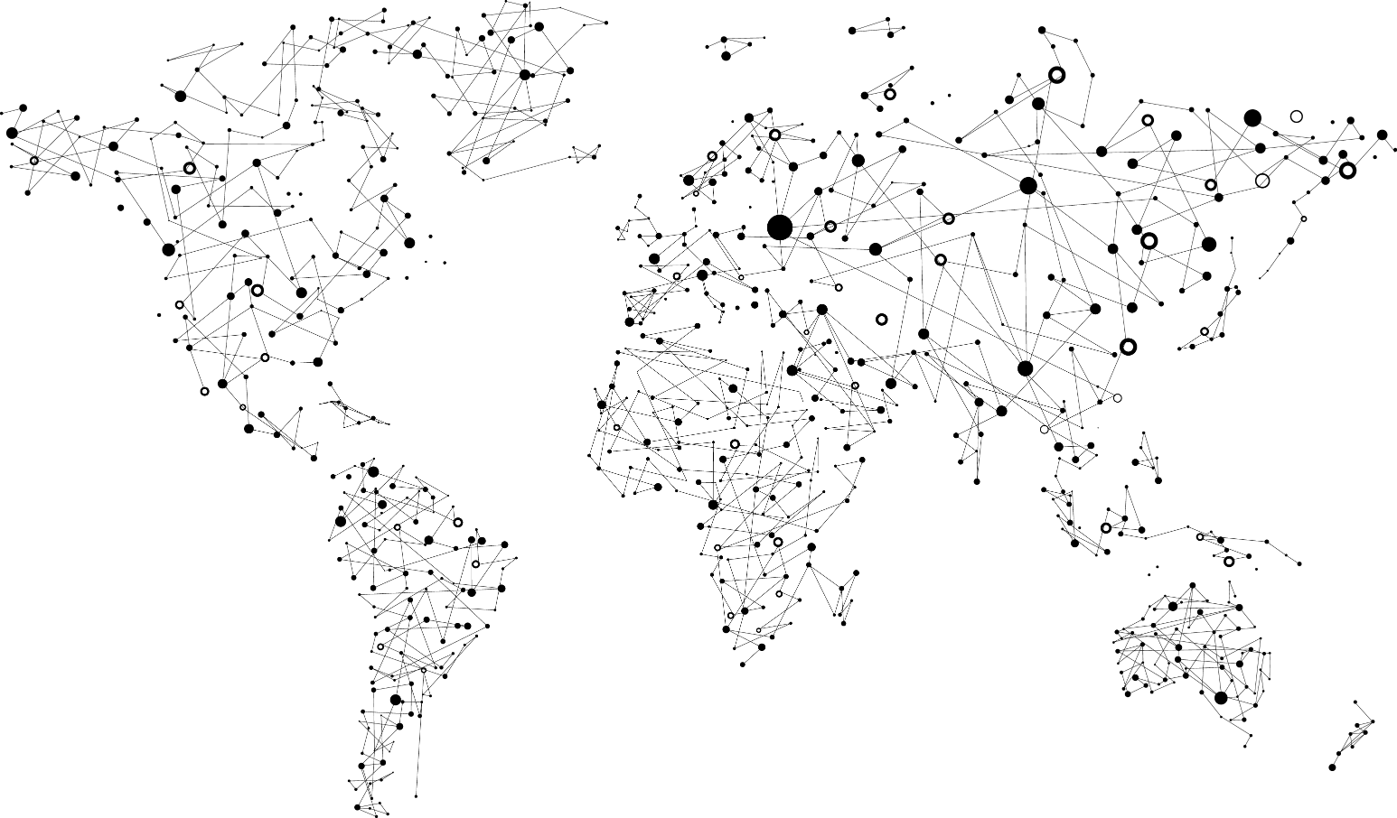
Achieve global scale, in local regions
Trust
38
Azure regions
RECENTLY LAUNCHED:
US Regions: West US 2 and West Central
Germany – Launched in Sep 2016
United Kingdom – Launched in Sep 2016
NEWLY ANNOUNCED:
France: France Central and France South
Korea: Korea Central and Korea South
DoD East and Central

Slide 9
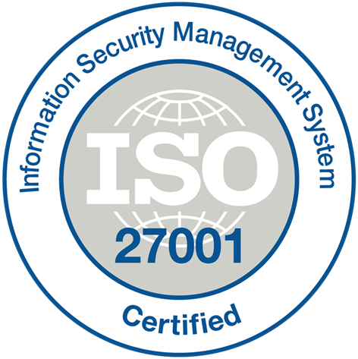

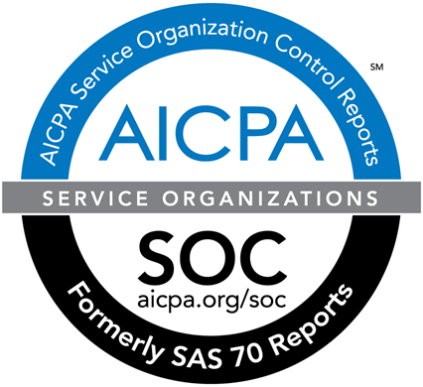





























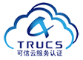











The most trusted and compliant cloud
Trust
GLOBAL
ISO 27001
ISO 27018
ISO 27017
ISO 22301
SOC 1
Type 2
SOC 2
Type 2
SOC 3
CSA STAR
Self-Assessment
CSA STAR
Certification
CSA STAR
Attestation
US GOV
Moderate
JAB P-ATO
High
JAB P-ATO
DoD DISA
SRG Level 2
DoD DISA
SRG Level 4
SP 800-171
FIPS 140-2
Section 508 VPAT
ITAR
CJIS
IRS 1075
INDUSTRY
PCI DSS
Level 1
CDSA
MPAA
FACT
UK
Shared
Assessments
FISC
Japan
HIPAA / HITECH Act
HITRUST
GxP
21 CFR Part 11
MARS-E
IG Toolkit
UK
FERPA
GLBA
FFIEC
REGIONAL
Argentina PDPA
EU
Model Clauses
UK
G-Cloud
China
DJCP
China
GB 18030
China
TRUCS
Singapore
MTCS
Australia
IRAP/CCSL
New
Zealand
GCIO
Japan My
Number Act
ENISA
IAF
Japan CS Mark Gold
Spain
ENS
Spain
DPA
India
MeitY
Canada
Privacy Laws
Privacy
Shield
Germany IT
Grundschutz
workbook

Slide 10
Microsoft Azure Offers
Application innovation
Accelerate innovation with the cloud
Data and intelligence
Power decisions & apps with insights
Trust
Protect your business
Openness and flexibility
Build freely, deploy anywhere
Notes:
Por lo que han visto en la semana

Slide 11

Build freely, deploy anywhere
Openness and flexibility
Build and run open source solutions
Extend on-premises with True Hybrid
Manage Your Identity

Slide 12








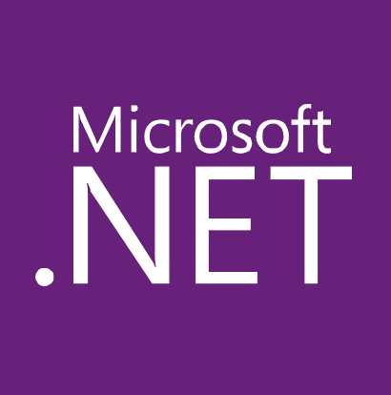

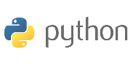
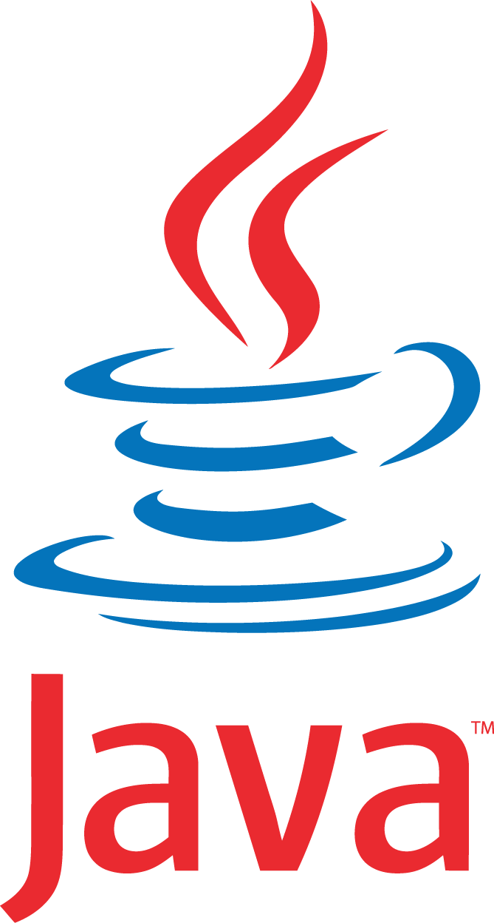








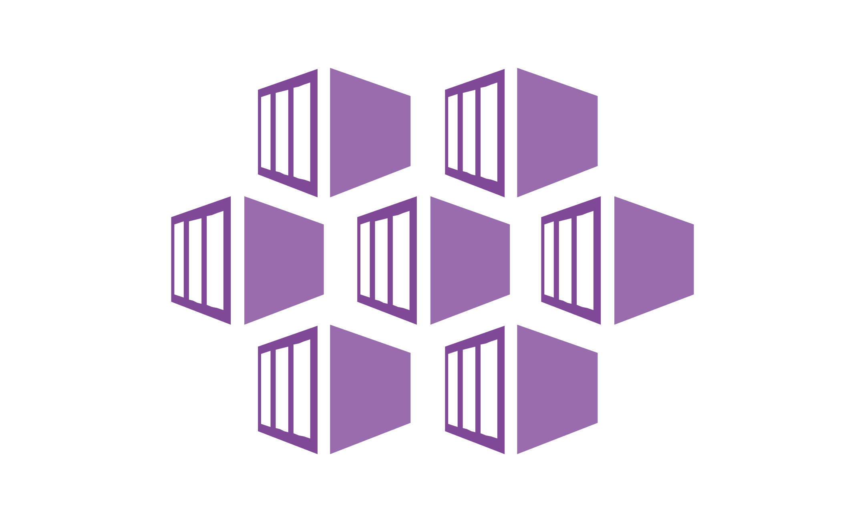

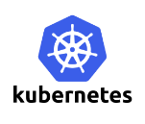


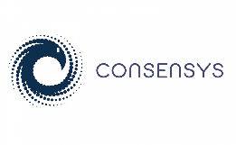
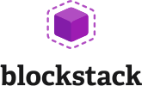
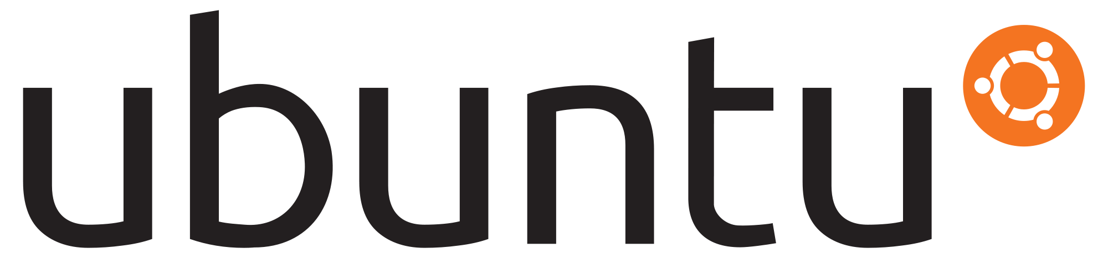


Build and run open source solutions
Openness and flexibility
Applications
DevOps
Frameworks
Databases & middleware
Containers
Infrastructure

Slide 13



Extend on-premises with True Hybrid
Openness and flexibility
Uniform Development
Compatible Data
Infrastructure Management & Security
Common Identity
Notes:
With Azure, you can take the investments you’ve made in data and intellectual property, and extend from on-premises to the cloud, or vice versa. Azure provides the portability to move your technology investments, whether open source or not, from cloud to on-premises and vice versa.
Companies fall into two main buckets with regards to hybrid: those who are using hybrid solutions as a temporary bridge to the cloud, and companies who are architecting hybrid solutions for use in perpetuity.
Amongst each of these types of customers, there are common use cases such as:
Application Availability
Bottomless Storage
Identity Management
Full hybrid applications
We provide seamless, secure hybrid cloud capabilities across infrastructure, data, users, apps, and management.
Azure
Azure’s true hybrid capabilities give you the flexibility to go to the cloud on your terms.
True hybrid isn’t just about infrastructure and connectivity — it offers consistency across your infrastructure, applications, identity, and data. In addition, Azure delivers consistent security and operations management across on-premises, public cloud, and even multiple public clouds.

Slide 14
Manage your identity
Openness and flexibility
Cloud identity
Synchronized identity
Federated identity
On-premises
directory
On-premises
directory
Zero on-premises servers
Directory sync with password sync
Federation
Directory sync
On-premises identity
On-premises identity

Slide 15


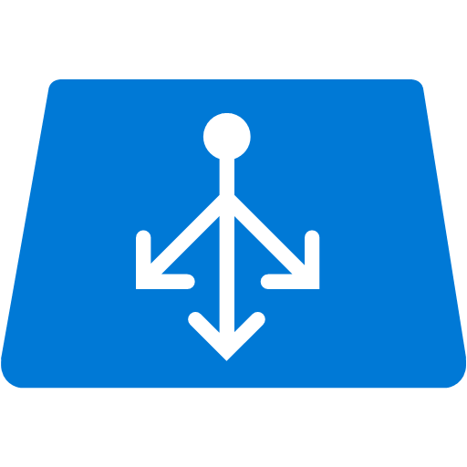



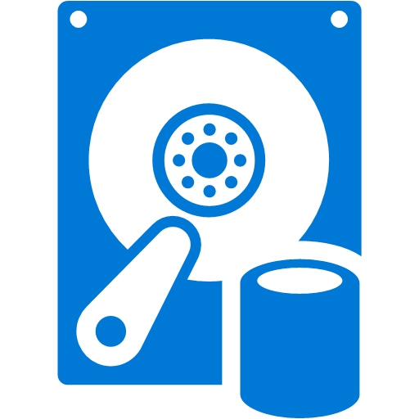
Azure Virtual Machines
Demo
Virtual Network
Public IP
Azure Load Balancer (external)
Subnet
Network Security
Group
Scale Set
Azure Load Balancer (internal)
Subnet
Network Security
Group
Availability Set

Slide 16
Gracias!

